Slide 1
File Handling
Aakanksha Chopra(Asst. Prof. (IT))

Slide 2
Open a file
Read a file
F
I
L
E
Write into a file
Close a file
Error handling during file
Command Line Arguments
Aakanksha Chopra(Asst. Prof. (IT))

Slide 3
What is a file????
A file is a collection of data stored on a secondary storage device like a hard disk.
Secondary storage devices are permanent storage devices.
Entering huge and large amount of data through terminal/ console Input-Output is not feasible in one go. A better solution is to combine all input data in one file and access that file through another file for various operations like read & write.
Aakanksha Chopra(Asst. Prof. (IT))

Slide 4
Cont..
Console I/O operations face two major problems-
It become hard to manage the large amount data due to its large size and it is time consuming to handle data through terminals or console I/O.
Data is lost when the program is terminated or the power is off. So we need to enter huge data again . There is no provision on console to restore the previously entered data.
Therefore, we need files for a permanent storage; device like DISK to store data, manage data, read and write data whenever, without data getting destroyed.
Aakanksha Chopra(Asst. Prof. (IT))

Slide 5
STREAMS
Standard streams are pre-connected input output channels between a text terminal and a program. Hence, a stream is a logical interface to the devices that are connected to the computer.
Stream is widely used as a logical interface to a file where a file can be a disk file, monitor, keyboard, etc.
The files may differ from each other in the content, the type of operation, file mode, but the streams are the same. Stream is linked to a file using open operation and disassociated from file using close operation.
Aakanksha Chopra(Asst. Prof. (IT))
Types of Standard Streams
Standard input(stdin)
Standard output(stdout)
Standard error(sterr)

Slide 6
STREAMS(CONT….)
Standard Input(stdin)- it is a stream from which a program receives its data. Its is like scanf(). Program requests the data transfer using READ operation. However there are programs which does not require input.
Standard Output(stdout)- it’s a stream where a program writes its output data. It is like printf(). Program requests the data transfer using WRITE operation. However there are programs which does not generate output.
Standard Error(stderr)- it’s an output stream used by a program to generate error messages. It is a stream independent of standard output and can be redirected separately also. Also sometimes the standard output and standard error can redirect to same destination i.e. SCREEN (See figure 1)
Aakanksha Chopra(Asst. Prof. (IT))

Slide 7
STREAMS(CONT….)
Aakanksha Chopra
KEYBOARD
stdin
PROGRAM
stdout
stderr
OUTPUT SCREEN
Fig 1. Showing data transfer between streams

Slide 8
BUFFERS???
When a stream is linked to a disk file a buffer is automatically created and associated with stream.
A buffer is a block of memory that is used for temporary storage of data that has to be read from or written to a file.
A buffer act as an interface between the stream(which is Character-oriented like- A Program) & disk hardware(which is block-oriented)
Need of buffers???
Generally, disk drives are block-oriented devices as they can operate efficiently when data has to be read/written in blocks of certain size. So buffers which are based on block-structure design are automatically incorporated and handled by Operating system. An Ideal buffer size is Hardware Dependent.
Aakanksha Chopra(Asst. Prof. (IT))

Slide 9
BUFFERS(cont….)
Fig 2. Showing buffer associated with streams
Data from buffer is written to the disk file as a block
Program writes to buffer block till it is full
PROGRAM
DISK
BUFFER
Program reads data from buffer
Data read as a block from disk file & written into the buffer
NOTE: C provides some functions for buffer manipulation. The data resides in the buffer until the buffer is flushed or written to a file.
Aakanksha Chopra

Slide 10
TYPES OF FILES
ASCII TEXT FILES-
A text file is a stream of characters that are sequentially processed by the computer in forward direction.
For the above reason the text files perform only one operation at one time(reading/ writing/ appending).
Text files processes only characters so these files can read or write a single character at a time.
In text file each line contains 0 or more chars. & ends with one or more chars. That specify end of line(like- ’\0’)
Max. number of 255 chars can come in one line.
If a line in program is not containing a string(might contain a number) then it is not terminated by NULL char.
Aakanksha Chopra(Asst. Prof. (IT))

Slide 11
ASCII Text File(cont…..)
When data is written to a text file each newline character is converted into a carriage return/line feed char. And when data is read from text file each carriage return/line feed char is converted into newline character.
In a text file each line ends with a newline character. And each file ends with a EOF(End Of File) character.
Text files store data differently in memory & in file—internal(in memory) & external(in file). Suppose an “int” value will be represented as 2 or 4 bytes internally but to externally store the data; “int” value is converted to string of chars representing its decimal or hexadecimal value.
To covert internal representation into external----- printf() & fprintf() is used.
To convert external representation into internal----scanf() & fscanf() is used.
Aakanksha Chopra(Asst. Prof. (IT))

Slide 12
2. BINARY FILES
A binary file is a collection of bytes. In C programming a byte and a character are equal.
A binary file hence is referred to as character stream with following 2 essential differences----
Binary file doesn’t require any special processing of the data & each byte of data is transferred to or from disk unprocessed.
Binary file could read sequentially or randomly unlike Text file. Binary file could be processed(read/written) in any manner depending upon application.
Aakanksha Chopra(Asst. Prof. (IT))

Slide 13
BINARY FILES(cont…)
Binary file store data in only internal representation format. Same format is used to store data in memory(which is internal) and in file(which is external).
Binary file also ends with EOF(End Of File) Character.
Binary files takes less space as compared to Text files (for eg- an “int” “123”is considered as ‘1’,’2’,’3’ will be stored in separate 3 bytes as char in Text files. But in binary file 123 will be stored as “123” “int” in only 2 bytes of memory.)
No conversion between internal and external representation is required in binary files hence they are more efficient as compared to text files
Aakanksha Chopra(Asst. Prof. (IT))

Slide 14
USING FILES
There are four steps followed for using files-
Aakanksha Chopra
1.Declare a file pointer
2.Open the file
3.Process the file
4.Close the file

Slide 15
1. Declare a file pointer-
Since there are number of files on the disk so we must specify the file name to perform any operation. This is done by declaring a file pointer variable that points to a structure FILE(defined in <stdio.h>).
An error will be generated if we use the filename to access a file rather than a file pointer.
FILE *file_pointer_name;
Eg- FILE *fp;
Aakanksha Chopra(Asst. Prof. (IT))

Slide 16
2. Opening a file-
A file must be opened first before reading from it or writing anything into it.
fopen()- is used to open a file. If file is opened successfully then fopen() returns a pointer-to –structure else a NULL is returned.
FILE *fopen(const char *filename, const char *mode);
OR
FILE *fopen(const char *pathname, const char *mode);
Eg- H:\C Programs\Files\Student.C;
WRITTEN AS
H:\\C Programs\\Files\\Student.C;

Slide 17
3. Process a file- using different modes
MODE | OPTION
r | Open a text file for reading. If file(stream)doesn’t exist, an error will be generated
w | Open a text file for writing. But If file doesn’t exist a new file is created. If file exist then previous contents are overridden by new.
a | Append to a text file. But if the file does not exist, it is created.
rb | Open a binary file for reading.
wb | Open a binary file for writing.
ab | Appends to a binary file.
r+ | Open a text file for reading & writing. It indicates that you want to read the file before you write to it. Hence, the file must exist.
w+ | Open a text file for reading & writing. The file will be created if it does not exist, If file exist then previous contents are overridden by new.
a+ | Open a text file for reading & writing. The file will be positioned at end of the file content.
r+b/rb+ | Open a binary file for read/write
w+b/wb+ | Create a binary file for read/write
a+b/ab+ | Append a binary file for read/write

Slide 18
4. Closing a file-
fclose()- to close a file fclose() function is used which disconnects a file pointer from file. It also flushes all the buffers that are maintained for that file.
If the file is not closed using fclose() then system closes it automatically when the program exits.
fclose()- returns 0 if the file is closed properly. Else a non-zero value is returned if an error occurred.
fcloseall()- closes all the files which were simultaneously opened for different operations. It returns number of file(stream) closed.
If file buffers are to be closed without closing a file then fflush() or flushall() are used to flush all buffers.
Aakanksha Chopra(Asst. Prof. (IT))
int fclose(FILE *fp);
int fcloseall(void);

Slide 19
Following codes tells how to open a file using fopen()
FILE *fp;
fp = fopen(“Student.C”, “r”);
If(fp==NULL)
{
printf(“\n Cannot open file”);
exit(1);
}
char filename[25];
FILE *fp;
gets(filename);
fp = fopen(“filename”, “r”);
If(fp==NULL)
{
printf(“\n Cannot open file”);
exit(1);
}

Slide 20
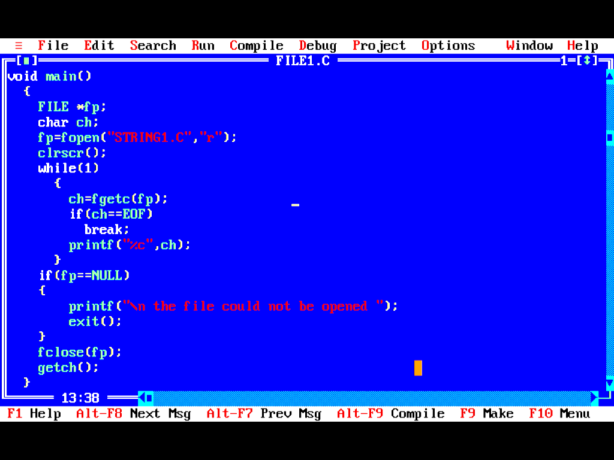
File showing use of fopen() and fclose(). This file is saved as FILE1.c and it is opening “STRING1.C” file in read(r) mode
Reads a character from the file

Slide 21
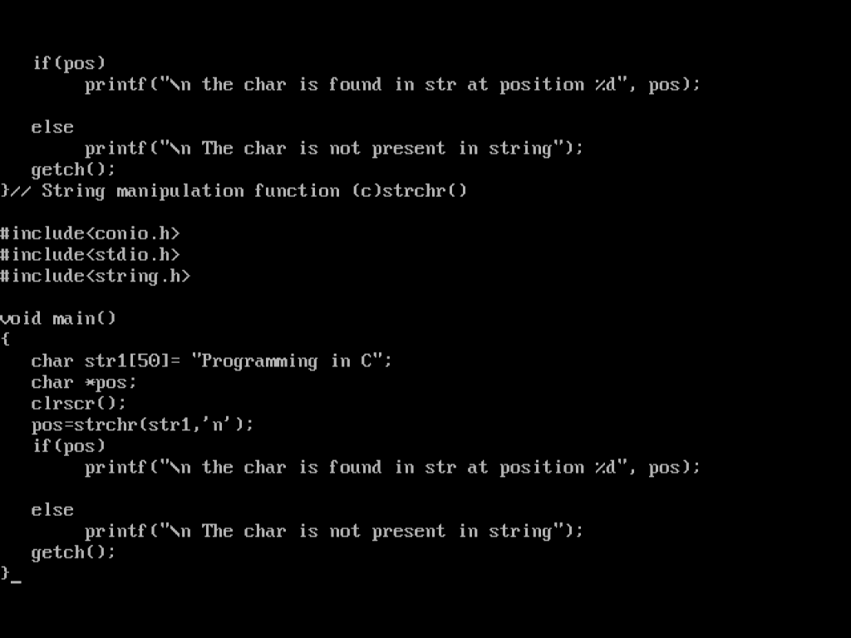
Output- opens STRING1.C file in read mode

Slide 22
READ DATA FROM FILES
Following four functions are used to read data from a file-
fscanf()
fgets()
fgetc()
fread()
Aakanksha Chopra(Asst. Prof. (IT))

Slide 23
1. fscanf()-
Used to read formatted data from the stream.
fscanf() is similar to scanf() except the first argument of fscanf() specifies the stream (or file) to read from.
int fscanf(FILE *stream, access specifiers, variables name);
Aakanksha Chopra(Asst. Prof. (IT))

Slide 24
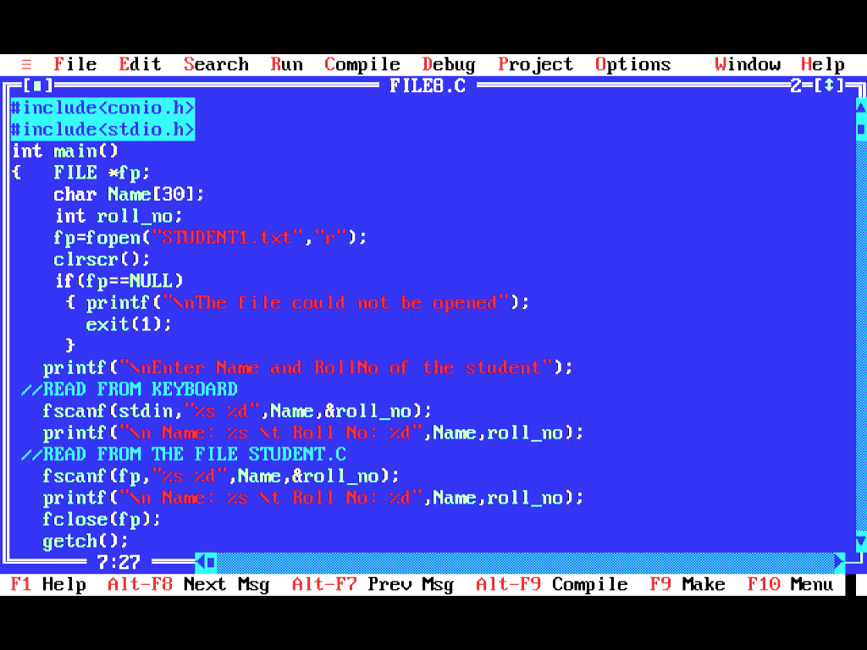
Program FILE8.C showing fscanf() that reads the string from the file “STUDENT1.TXT” and from “stdin”.
Reading from stdin i.e console I/O
Reading from the file pointed to by fp pointer

Slide 25

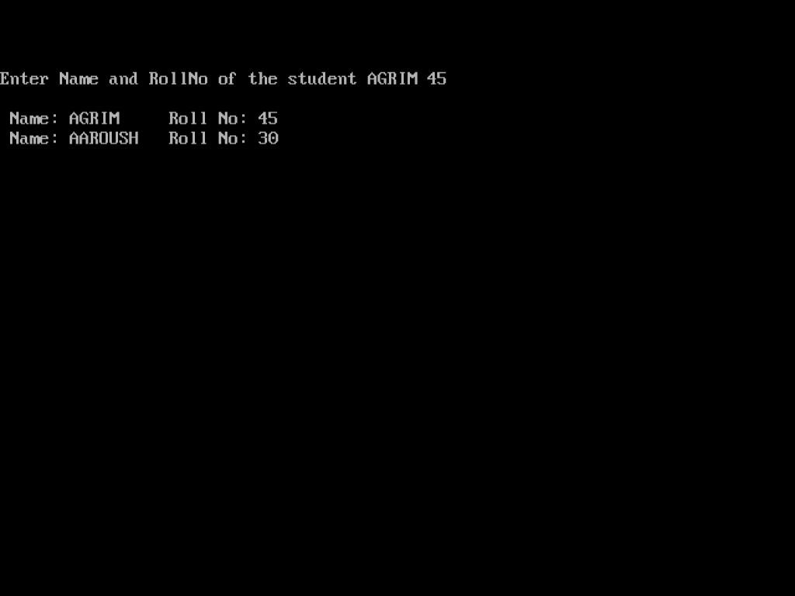
Coding for “STUDENT1.TXT”
Output of “FILE8.C” showing two outputs one read from “stdin” another from “STUDENT1.TXT” file

Slide 26
2. fgets()- stands for file get string
It is used to get string from the file/stream.
It reads at most one char less than the size specified(it reads till before’\0’) and stores it into string “str”
fgets() terminates as soon as it founds either a EOF or if an error occurs. However if a newline char is found it is retained.
When all chars are read without any error a ‘\0’ char is appended to the end of the string.
EOF has a integer value as -1 & is defined in <stdio.h>
Aakanksha Chopra(Asst. Prof. (IT))
char fgets(char *str, int size, FILE *stream);

Slide 27
DIFFERENCE BETWEEN gets() and fgets()
gets() | fgets()
It is of infinite size. Can read a string of infinite size. | Finite size. Can read only till the last character in the file.
It is a stream of stdin. | It is reading from a file rather than standard input/ terminal.
It does not retain a newline character i.e it does not stores a new line character in a string | It retains a newline character.
It just gets the string | On reading a file successfully it returns str.
No such provision is there in gets() | If stream is at EOF, then EOF indicator will be set & fgets() returns a NULL pointer.
No such provision is there in gets() | If error occurs while reading then Error indicator will be set & a NULL pointer will be returned.

Slide 28
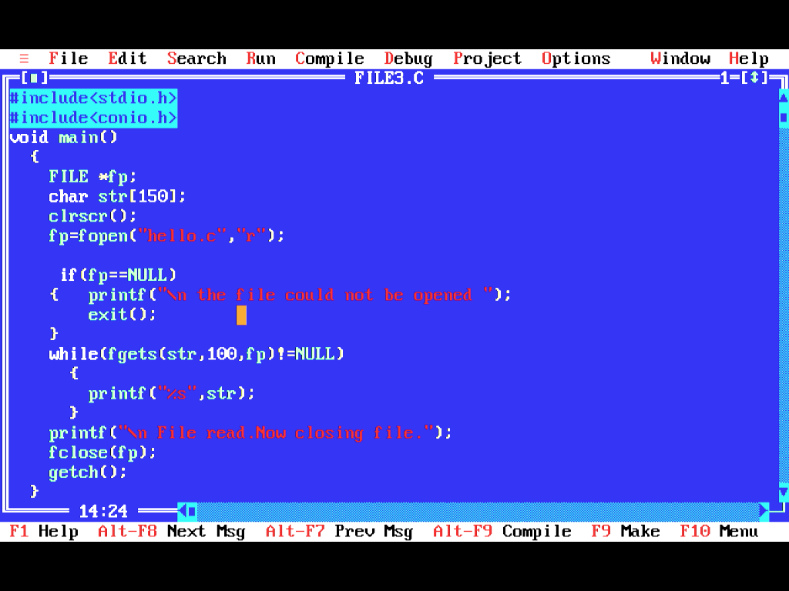
Reads only 100 characters from file pointed by fp and stores in string str
Program FILE3.C showing fgets() reads the string from the file “HELLO.C”.

Slide 29
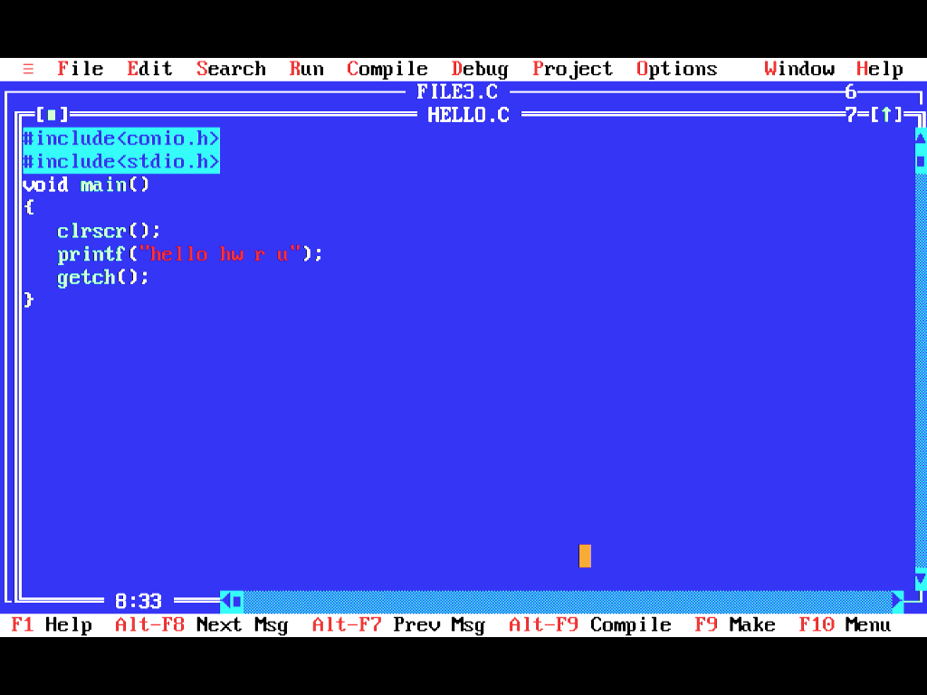

Coding for “HELLO.C”
Output of “HELLO.C”

Slide 30
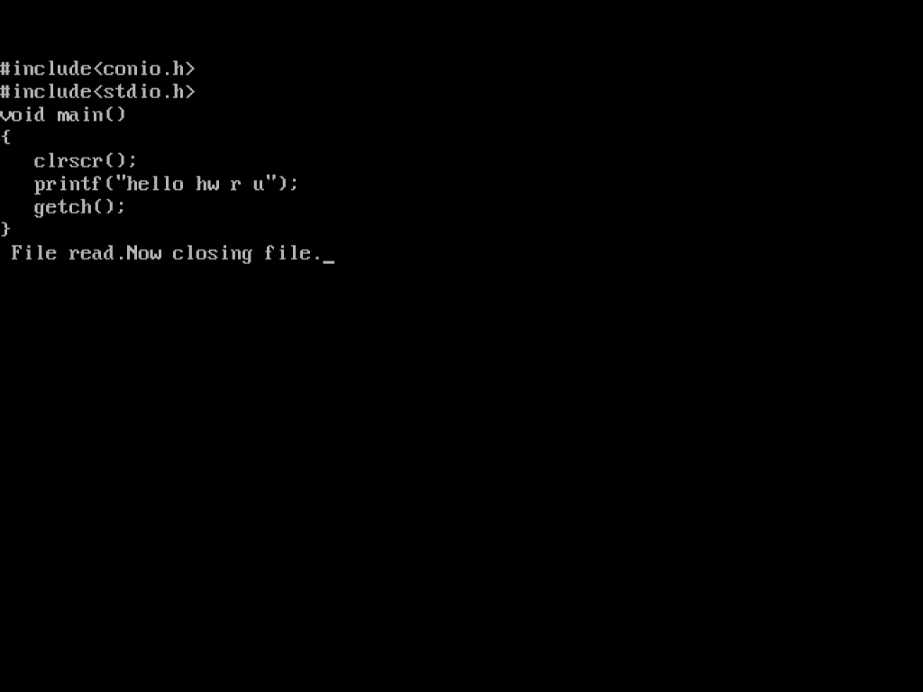
OUTPUT OF “FILE3.C” reading string from the file “HELLO.C”
Aakanksha Chopra(Asst. Prof. (IT))

Slide 31
3. fgetc()-get the character from the file
It returns next char from the stream(as it reads one char at a time); or returns EOF if end of file is reached, or if an error occurred.
fgetc() returns a character read as an “int” or returns EOF if file has ended or if any error occurred.
It reads one char at a time so function increments the file pointer to point to the next char. However if EOF has reached the EOF indicator for the stream is set.
feof() is used to detect end of file. feof()=0 if no error and feof()=1 if there is an error
int fgetc(FILE *stream);

Slide 32
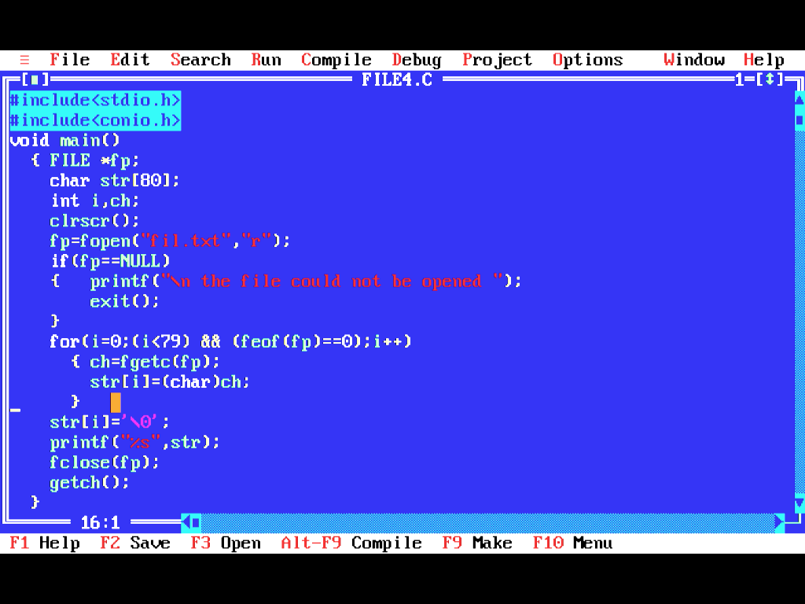
Program FILE4.C showing fgetc() reads the character from the file “fil.txt”.
For detecting end of file. Also It returns O if end of file has not reached.
Converting to char as it reads int

Slide 33
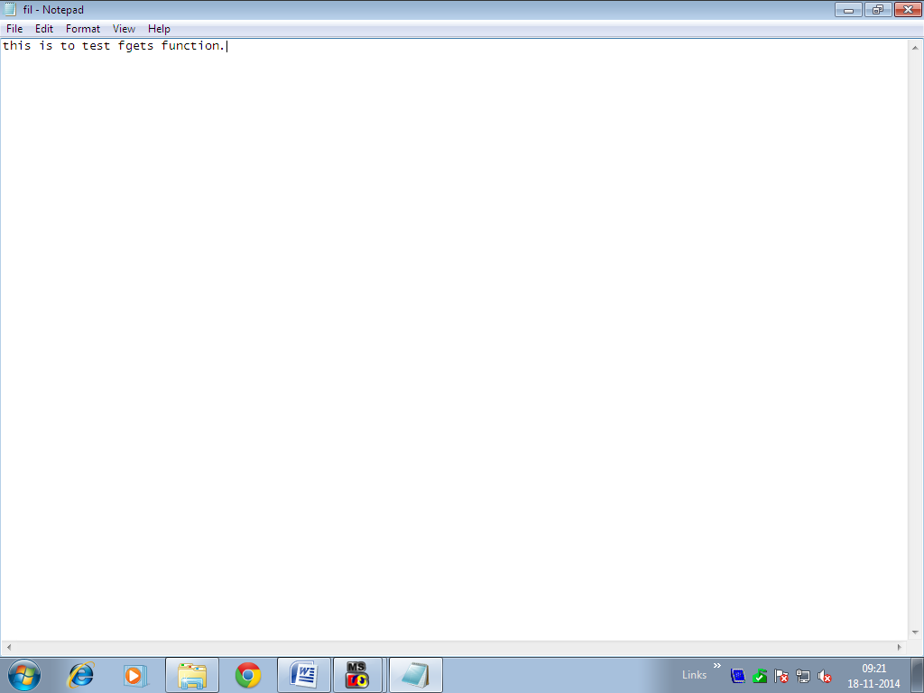
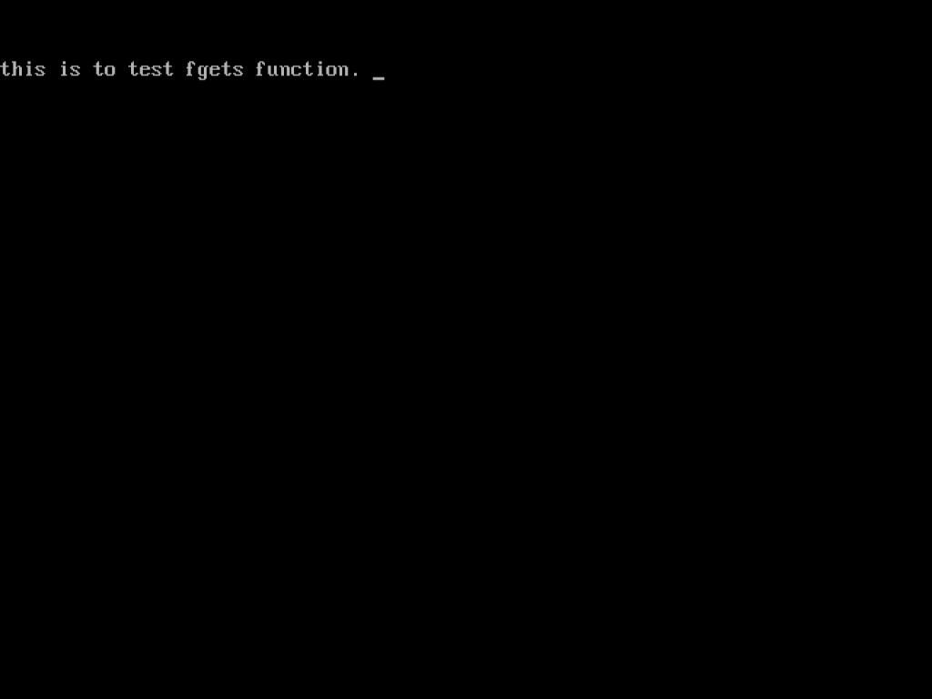
File “fil.txt” which is a text file opened in notepad
Output of “FILE4.C” reading the contents of “fil.txt” file

Slide 34
4. fread()- reads data from the files
It reads ‘num’ number of objects(where each object is of size bytes) & places them into a array pointed to by str. The data is read from the given input stream.
On reading file successfully fread() returns number of bytes successfully read. The number of objects will be less than “num” If an error occurred or EOF has reached before.
If “num” is set to 0 then fread() will return 0 & the contents of str & state of stream remains unchanged.
fread() cannot distinguish between EOF or error so programmer must use feof() or ferror() to find the same.
int fread(char *str, size_t size, size_t num, FILE *stream);

Slide 35
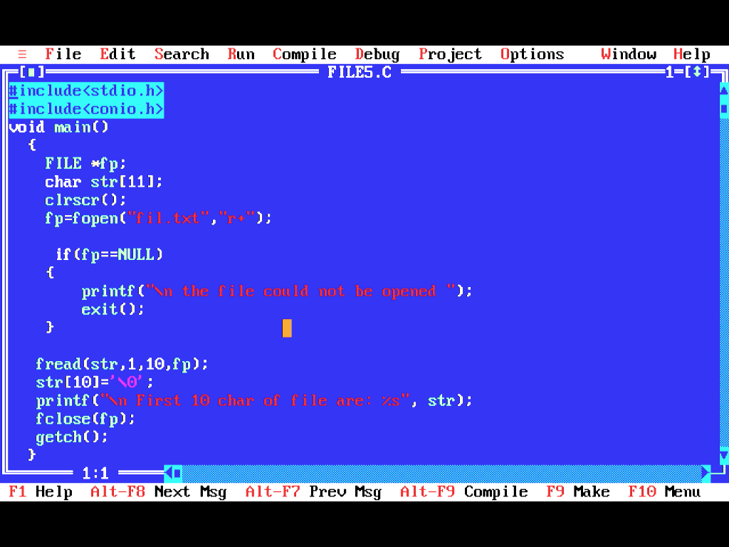
Program “FILE5.C” reading “fil.txt” file using fread() which is reading first 10 characters
Appends ‘\0’ to the last char.

Slide 36
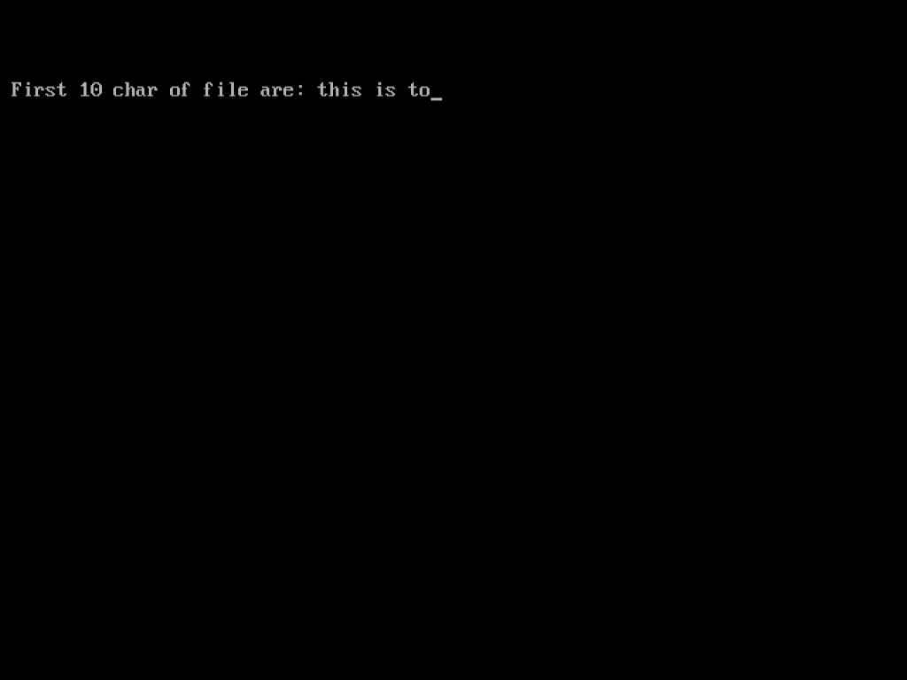
File “fil.txt” which is a text file opened in notepad
Output of “FILE5.C” reading the contents of “fil.txt” file and displaying first 10 characters of the file after fread()

Slide 37
WRITING DATA INTO FILES
Following four functions are used to read data from a file-
fprintf()
fputs()
fputc()
fwrite()
Aakanksha Chopra(Asst. Prof. (IT))

Slide 38
1. fprintf()-
Used to write formatted output to the stream.
fprintf() is similar to printf() except the first argument of fprintf() specifies the stream (or file) to write data into.
for printing on the screen we can also specify stdout rather than stdin in fscanf()
int fprintf(FILE *stream, access specifires, variables name);
Aakanksha Chopra(Asst. Prof. (IT))

Slide 39
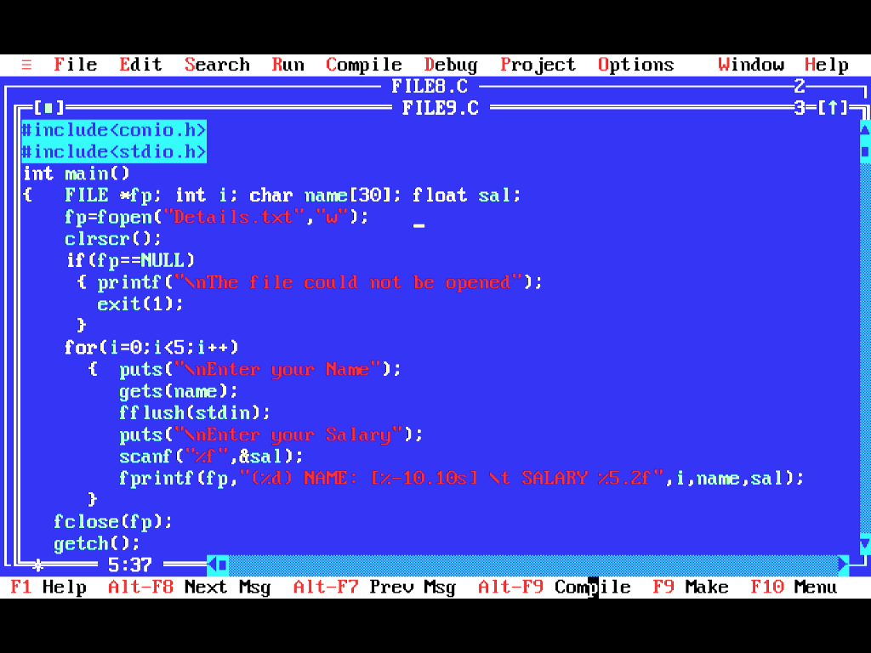
Program FILE9.C showing fprintf() that writes data into the file “Details.TXT”

Slide 40

Console screen of “FILE9.C” writing data into the file “details.txt” if the file exist the previous data gets overridden by new. Else if file does’nt exist then a new file with ”Details.txt” is created in the same directory.

Slide 41
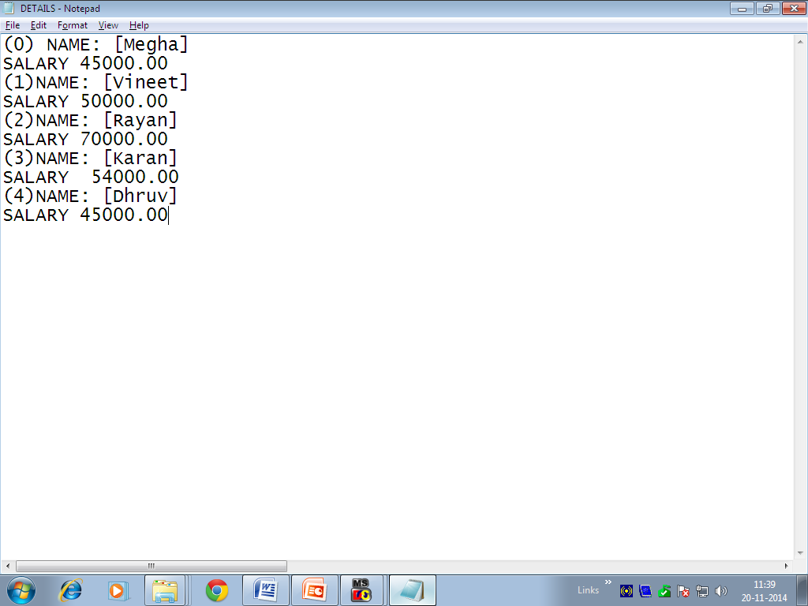
Text file “Details.txt” is created with the data entered by fprintf()
Aakanksha Chopra(Asst. Prof. (IT))

Slide 42
2. fputs()- writes a line to file
It writes a string pointed to by “str” to the file pointed to by stream.
If completed successfully it returns 0. if error occurs EOF is returned.
int fputs(const char *str, FILE *stream);
Aakanksha Chopra(Asst. Prof. (IT))

Slide 43
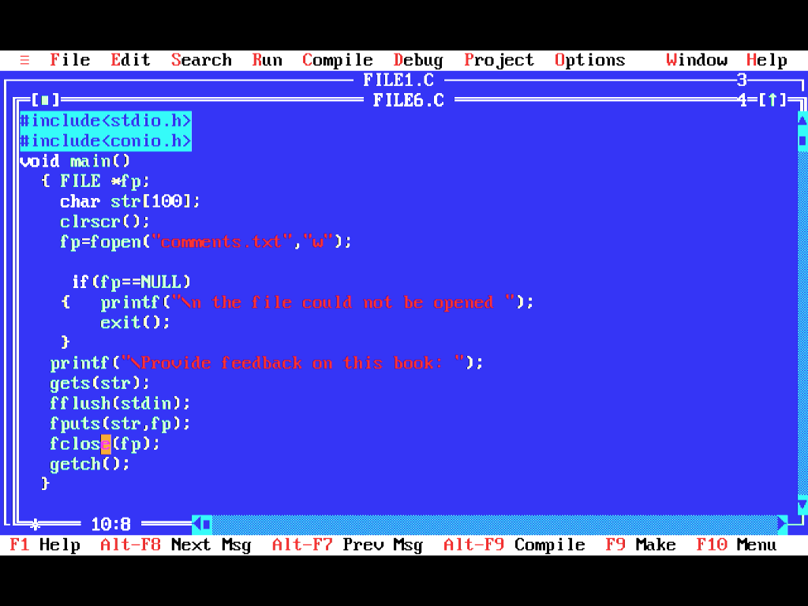
Program FILE6.C showing fputs() that writes data into file “commnets.txt”.
Read the str using gets()
Writes str string to the file pointed by fp

Slide 44

File “COMMENTS.TXT” before write operation
Aakanksha Chopra(Asst. Prof. (IT))

Slide 45
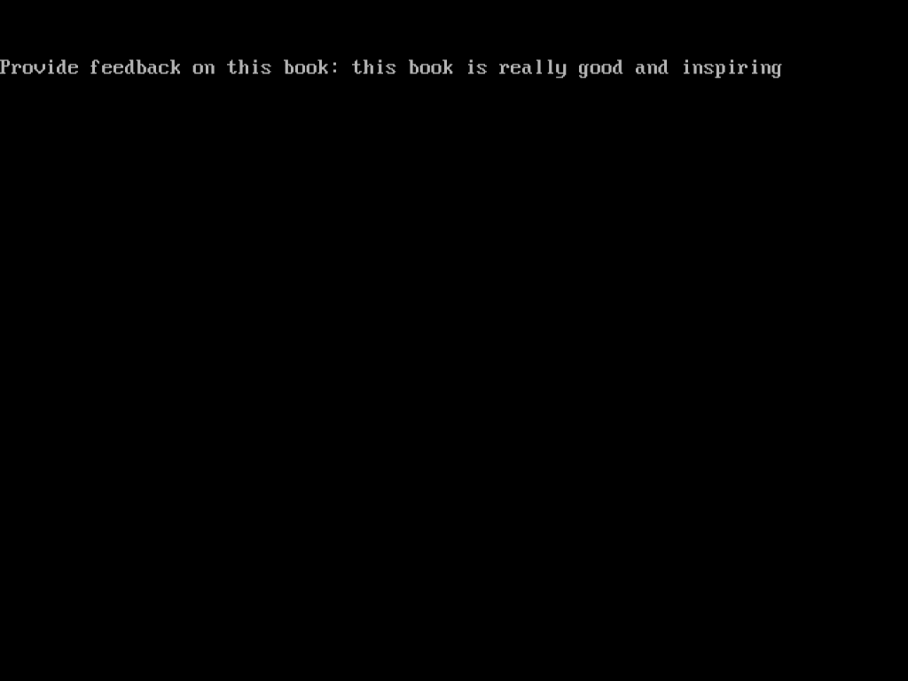
OUTPUT OF FILE6.C Performing write operation
Aakanksha Chopra(Asst. Prof. (IT))

Slide 46
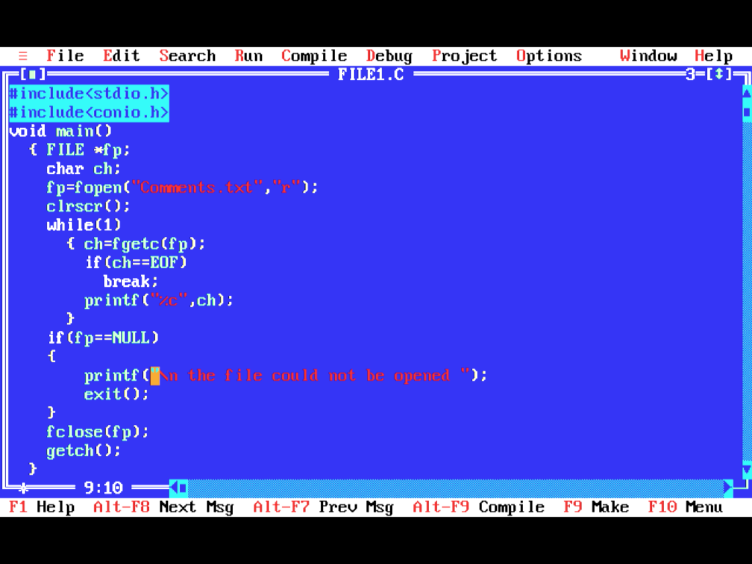
Now Check the updations after write operation in Comments.txt file. using fopen() in read mode .So or that we need to read the file first so we apply read operation on Comments.txt file and see the output.

Slide 47
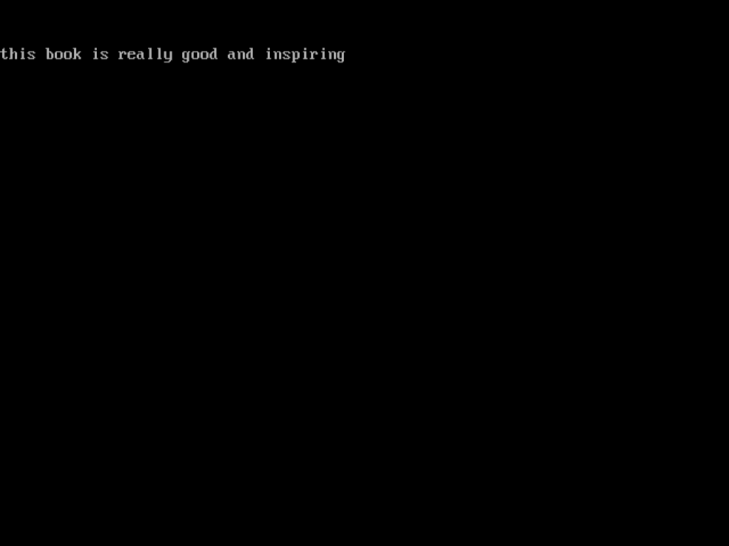
After reading the file following is the file output. The file containing content as “OK” has been updated as “this book is really good and inspiring” due to write operation as it has overridden previous operation.
Aakanksha Chopra(Asst. Prof. (IT))

Slide 48
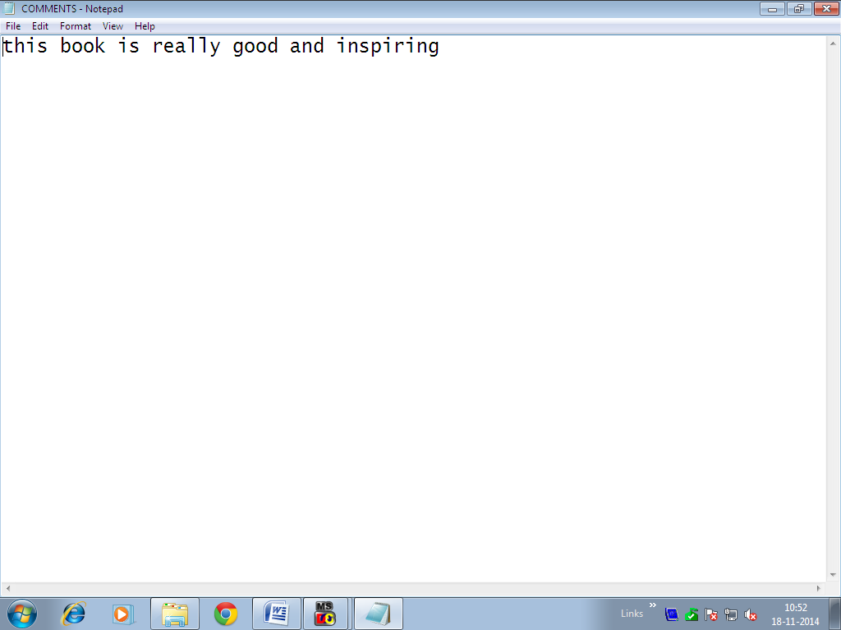
Even the text file(notepad file) has been updated- from “ok” to “this book is really good and inspiring”
Aakanksha Chopra(Asst. Prof. (IT))

Slide 49
3. fputc()-writes a character to the stream
It writes the byte specified by c(converted into unsigned char) to the O/P stream pointed to by stream.
on successful completion fputc() will return the value it has written. If error occurs it returns EOF & the error indicator for the stream is set.
int fputc(int c, FILE *stream);
Aakanksha Chopra(Asst. Prof. (IT))

Slide 50
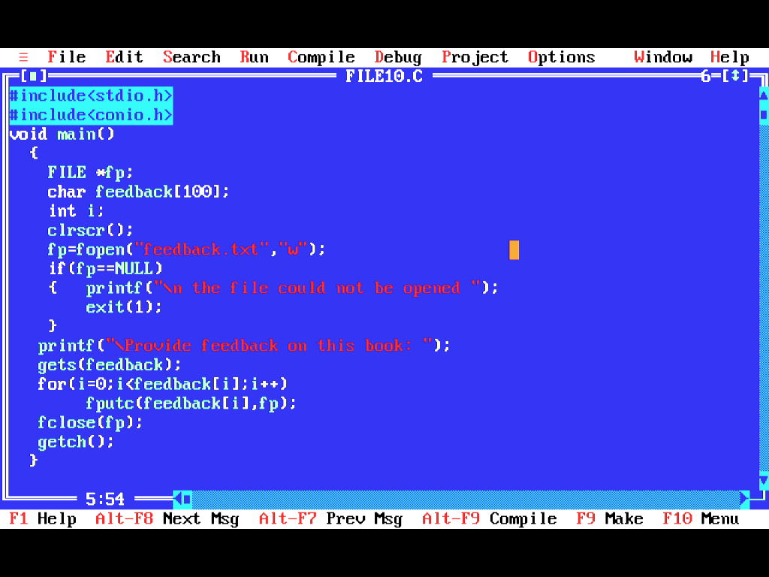
Program FILE10.C showing fputc() writing character into the new file “feedback.txt”.
Put char by char to the file pointer fp

Slide 51
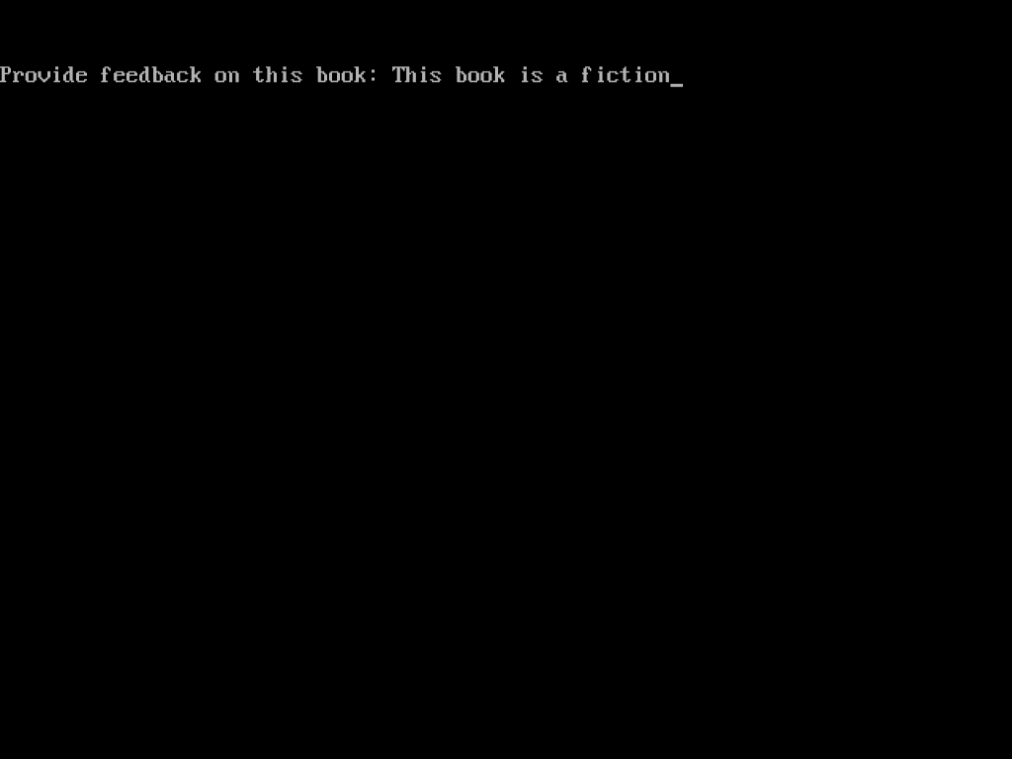
Output of “FILE10.c”
Aakanksha Chopra(Asst. Prof. (IT))

Slide 52
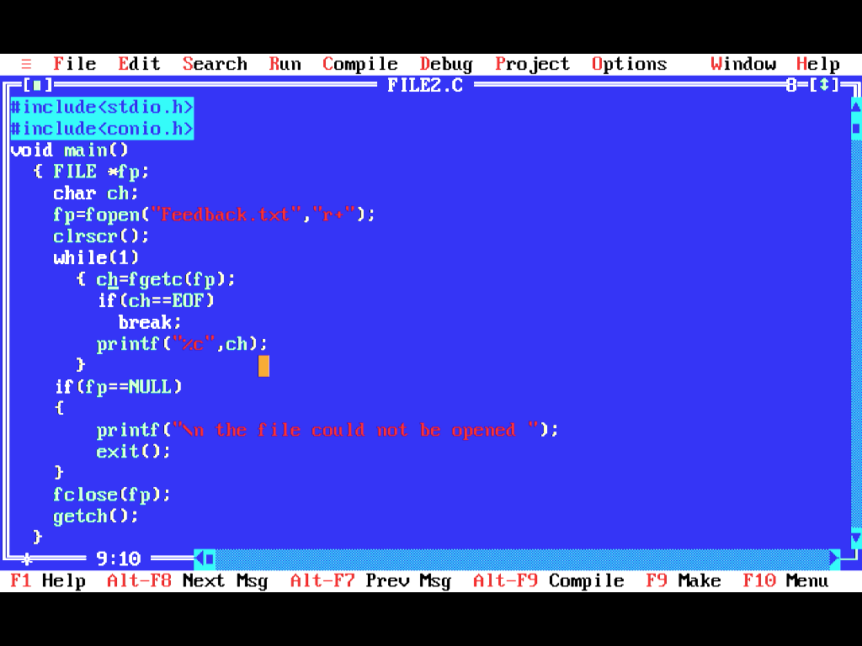
Reading the file ”feedback.txt” by calling fopen()

Slide 53
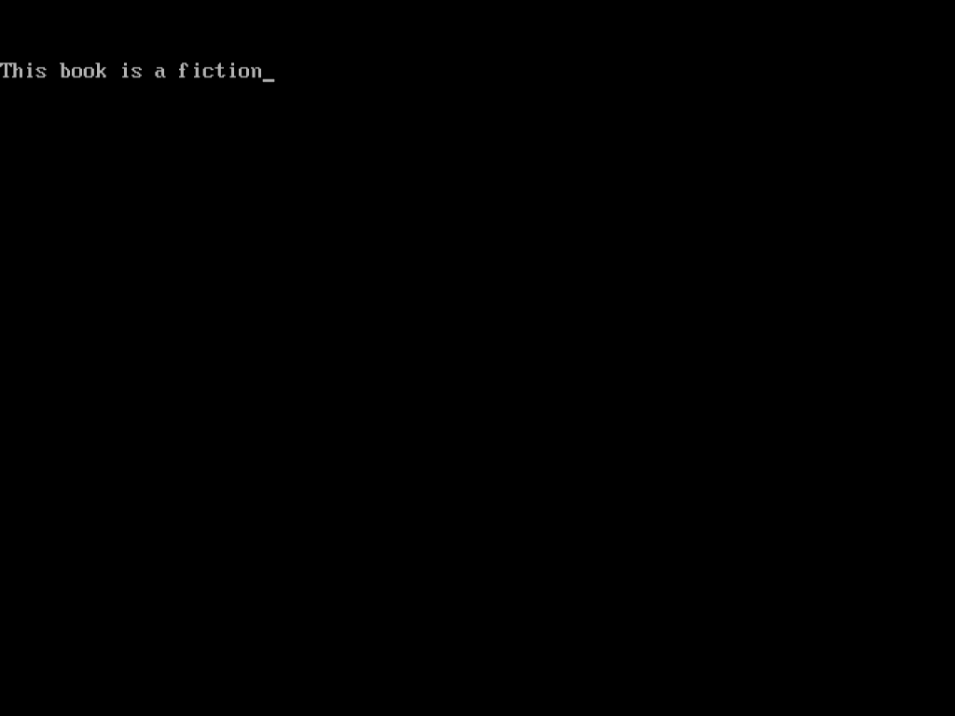
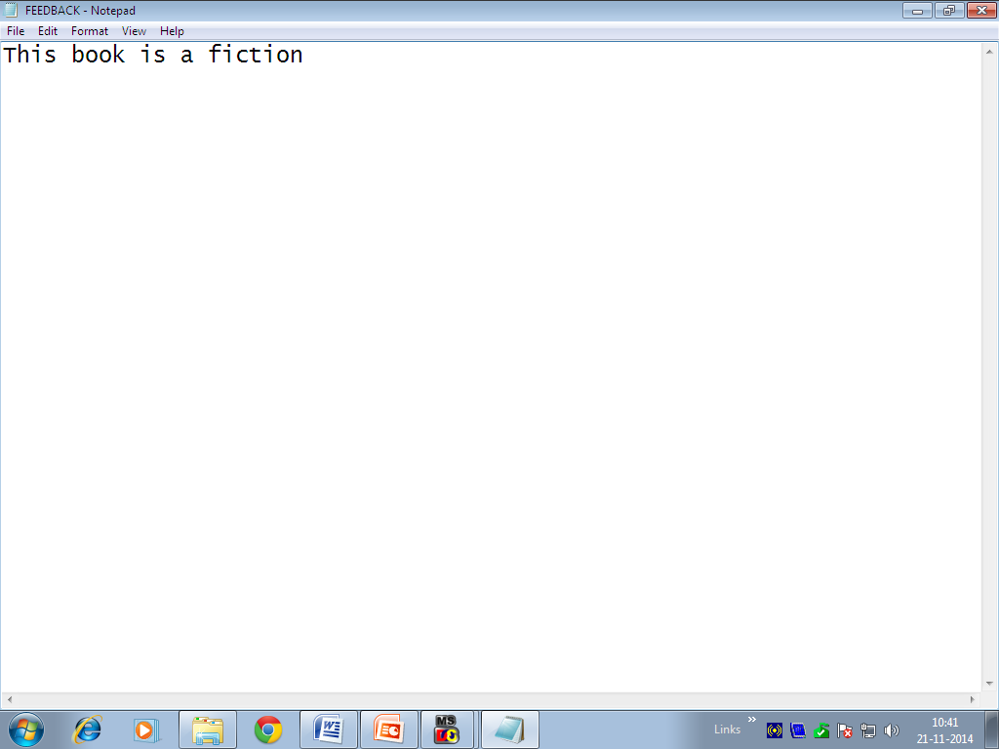
Output after reading the file”feedback.txt” using fopen() in read mode
Notepad file of “Feedback.txt”
Aakanksha Chopra(Asst. Prof. (IT))

Slide 54
4. fwrite()- writes data to the files
It write objects(no. of objects are specified by ‘count)’ of size specified by “size”; from the array pointed to by “str” to the stream pointed by “stream.”
On successful completion fwrite() returns no. of objects(or bytes) written correctly. The no. of chars will be less than count if an error found.
If size of count is 0, fwrite() returns 0 & contents of stream remains unchanged.
int fwrite(const char *str, size_t size, size_t count, FILE *stream);

Slide 55
4. fwrite() (cont……)-
If error occurs, resulting value of the file position indicator for the stream is unspecified- i.e NO ERROR IS DETECTED.
fwrite() could be used to write characters, structures, integers to a file.
fwrite() can only be used with files that are opened in binary mode.(see the next prog using “wb” as the mode with fwrite() which is write to a binary file.)
Aakanksha Chopra(Asst. Prof. (IT))

Slide 56
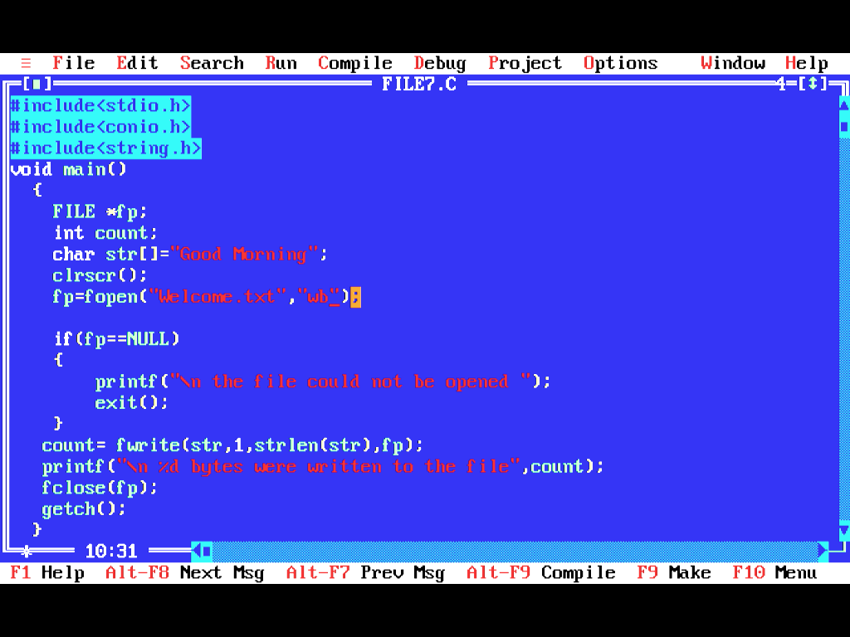
Program “FILE7.C” writing into a new file “Welcome.txt” file using fwrite() which is writing characters
“wb”
Writing str string to welcome.txt by counting the length of str

Slide 57
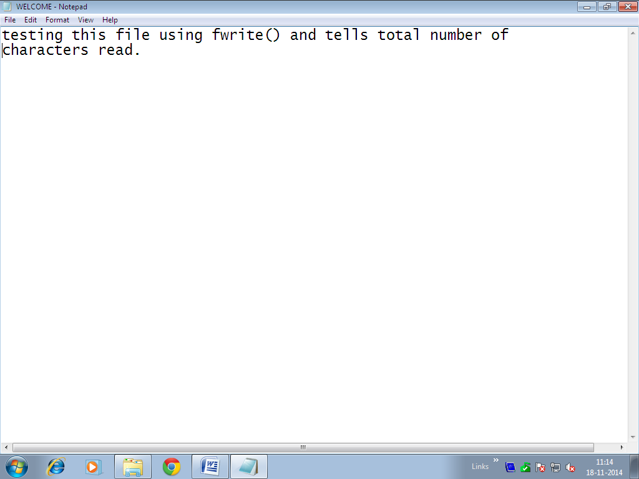
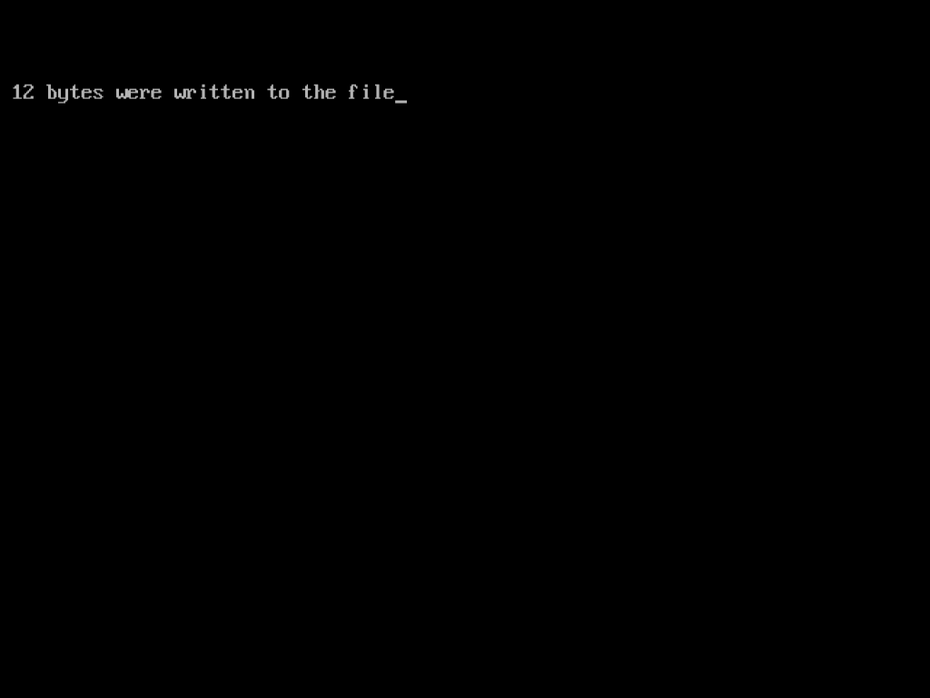
File Welcome.txt file before fwrite() operation
Output of “FILE7.C”

Slide 58
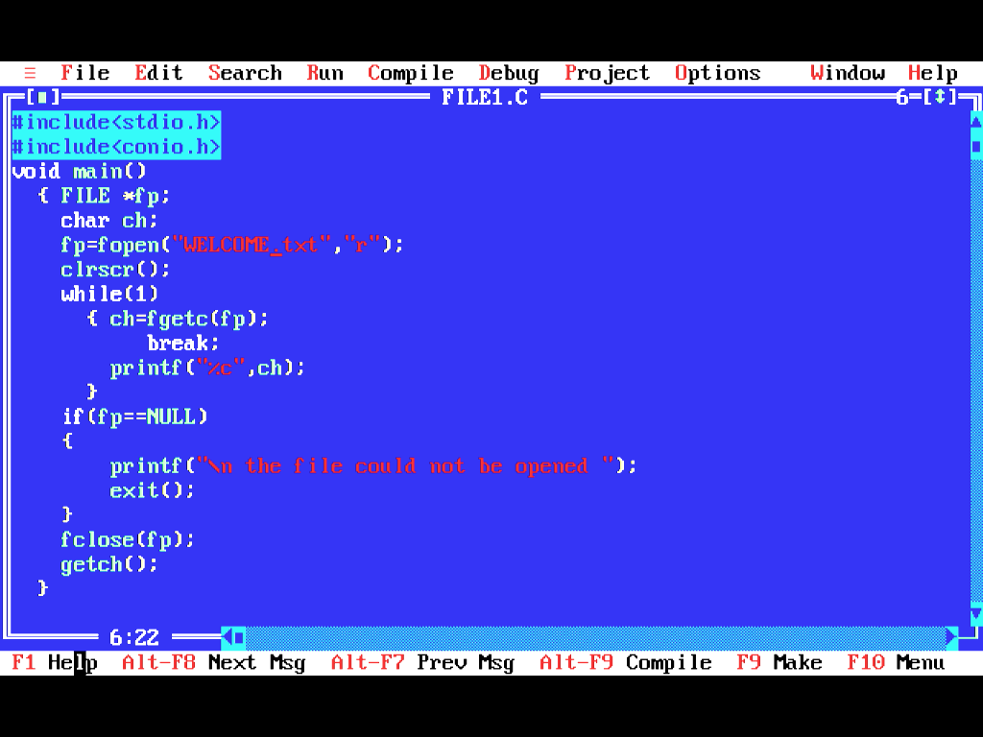
Reading The “Welcome.Txt” File After Writing 12 Bytes Using fopen() In read Mode

Slide 59


Output of “FILE1.c” after reading the file using fopen()
Changes Made To text File “ Welcome.Txt”. New 12 Bytes Written To The File. Now the contents is “Good Morning”
Aakanksha Chopra(Asst. Prof. (IT))

Slide 60
DETECTING END-OF-FILE
The size of file is never know in advance to the program in read or write operation. So in order to detect end-of-file following 2 methods are used.
Read the file in text mode, char by char & compare each char with EOF., which is defined in <stdio.h> & have a value as -1
while(1)
{
int c=fgetc(fp);
if(c==EOF)
break;
printf(“%c” ,c);
}

Slide 61
2. Second way is use standard library function feof() which is defined in <stdio.h>. It is used in following 2 cases-
2.a. When a stream operation has reached the end of file. The feof() returns 1(TRUE)
2.b. When the EOF error code, has returned an error indicator even when the file has not ended. The feof() returns 0(FALSE) in that case.
int feof( FILE *stream);
Aakanksha Chopra(Asst. Prof. (IT))

Slide 62
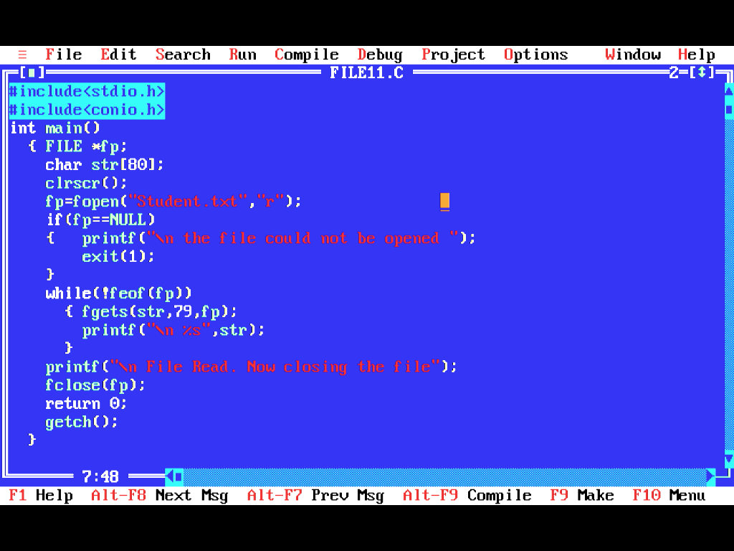
Program checks use of feof()
Loop Continues till fp Reaches End-of-file
Reads 79 bytes at a time

Slide 63
ERROR HANDLING DURING FILE OPERATIONS
Error may occur while reading from or writing to a file.
It may occur in following situations-
1. Reading a file beyond EOF indicator.
2. Reading a non -existing file.
3. Trying to use a file that has not been opened.
4. Trying to use a file in an inappropriate mode- i.e writing data to a file which is opened in read mode.
5. Writing to a file which is write protected(i.e. read-only file)
Aakanksha Chopra(Asst. Prof. (IT))

Slide 64
If the errors are not checked properly then the program may behave abnormally, or may result into a premature termination or an incorrect output.
ferror() is used for checking error if any. It returns zero(O) if no error occurred and returns a non-zero value if an error occurred.
int ferror( FILE *stream);
Aakanksha Chopra(Asst. Prof. (IT))

Slide 65
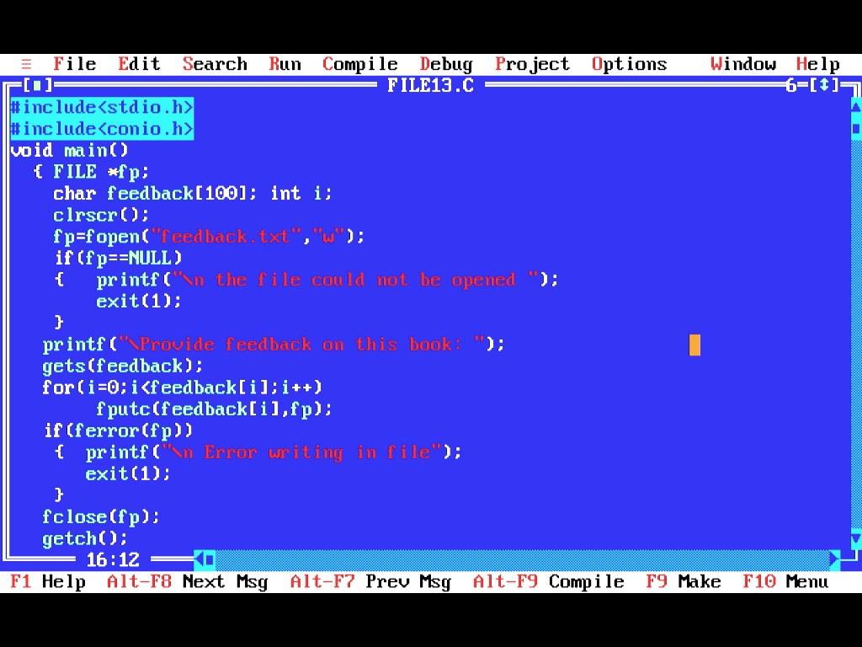
If in the following program error occurs while writing feedback; then program will terminate displaying the message as ”Error writing the file” on the screen

Slide 66
COMMAND LINE ARGUMENTS(CLA)
It is possible to pass arguments to C Programs when they are executed.
CLA was a name given after the name of a prog in command-line Operating System like DOS or LINUX, and passed into the prog from DOS.
Aakanksha Chopra(Asst. Prof. (IT))

Slide 67
Use of Command Line Arguments??
1. When we want to control the program from outside rather than inside.
2. The command line arguments are handled using main(), arguments where argc refers to the number of arguments passed and argv[] is pointer array which points to each argument passed to program.
Aakanksha Chopra(Asst. Prof. (IT))

Slide 68
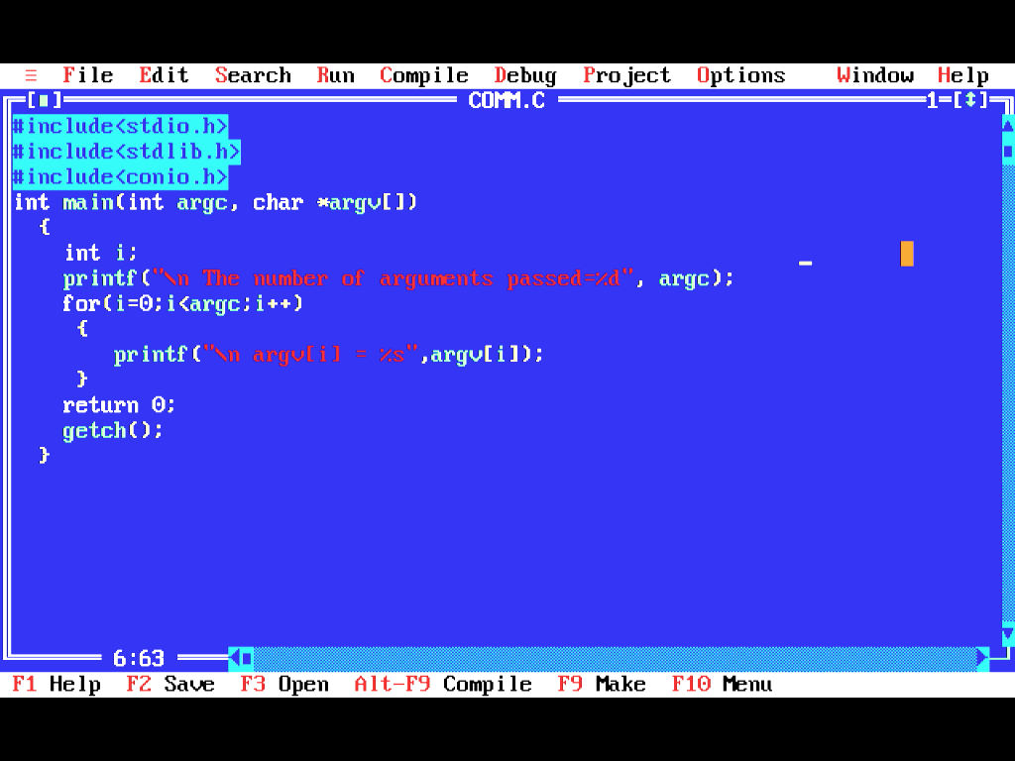
Program comm.c

Slide 69
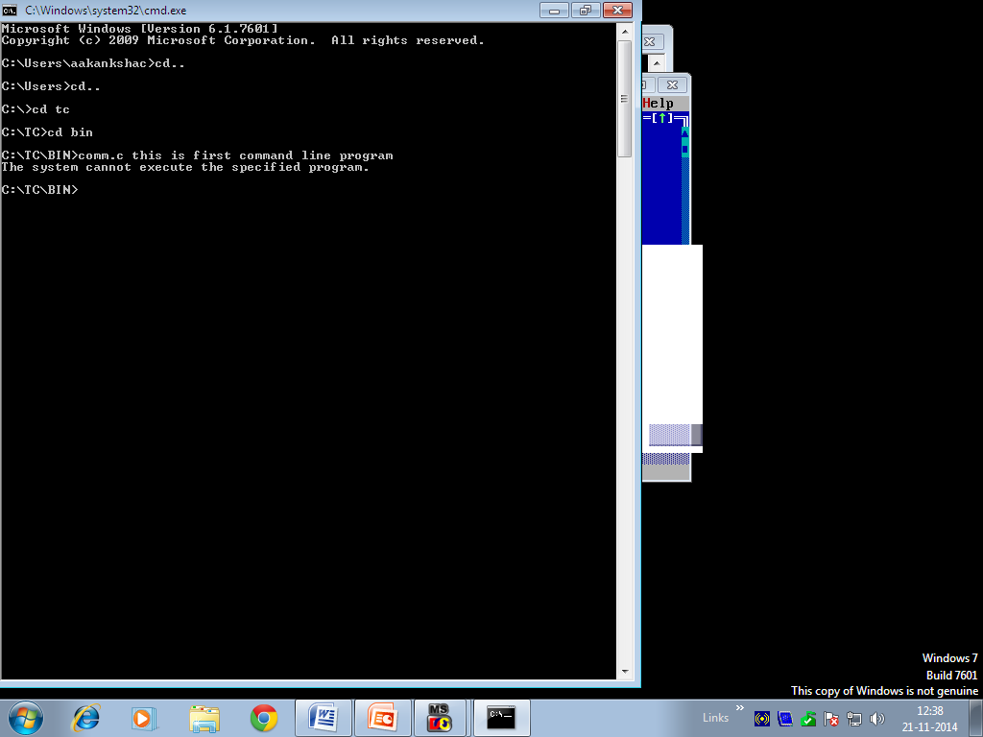
Console output of cmm.c
File name passed
6 Arguments passed
Output of the prog. If executed correctly will write
“this is first command line program”

Slide 70
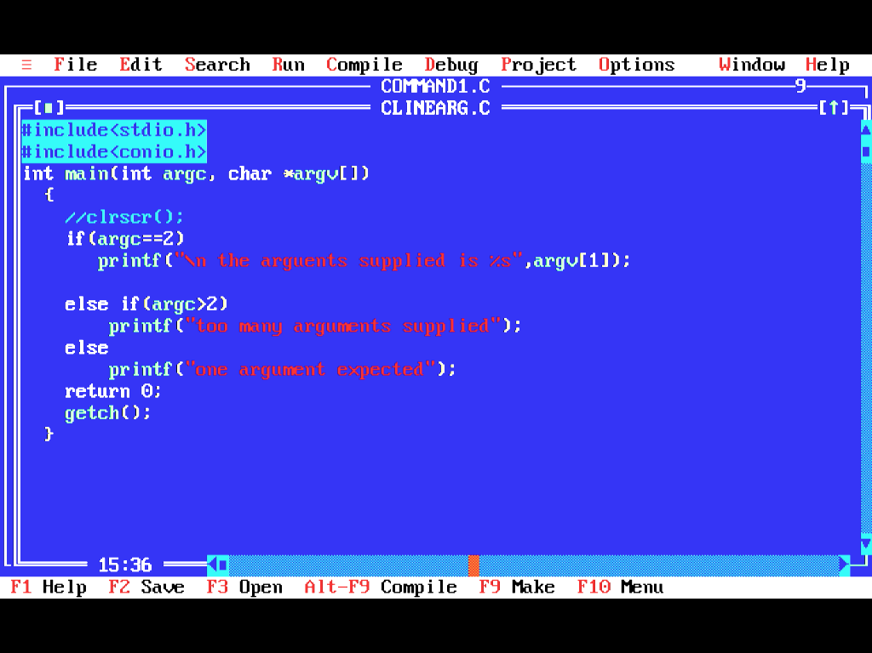
Program Clinearg.c

Slide 71
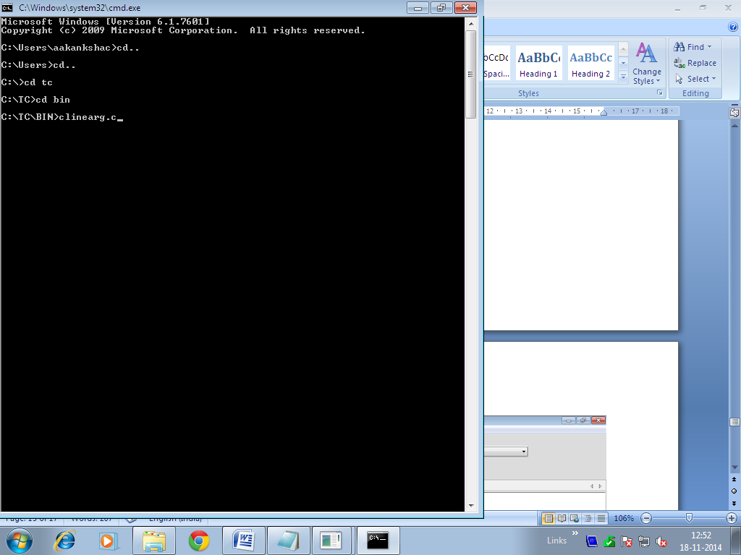
Opening the file using command prompt of clinearg.c
No argument passed on with file name

Slide 72
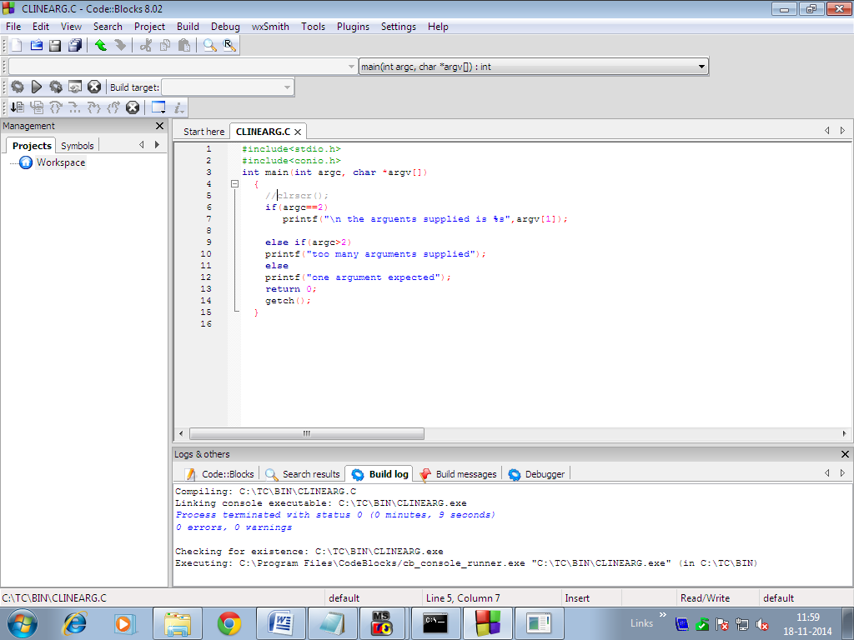
Code blocks code opened

Slide 73
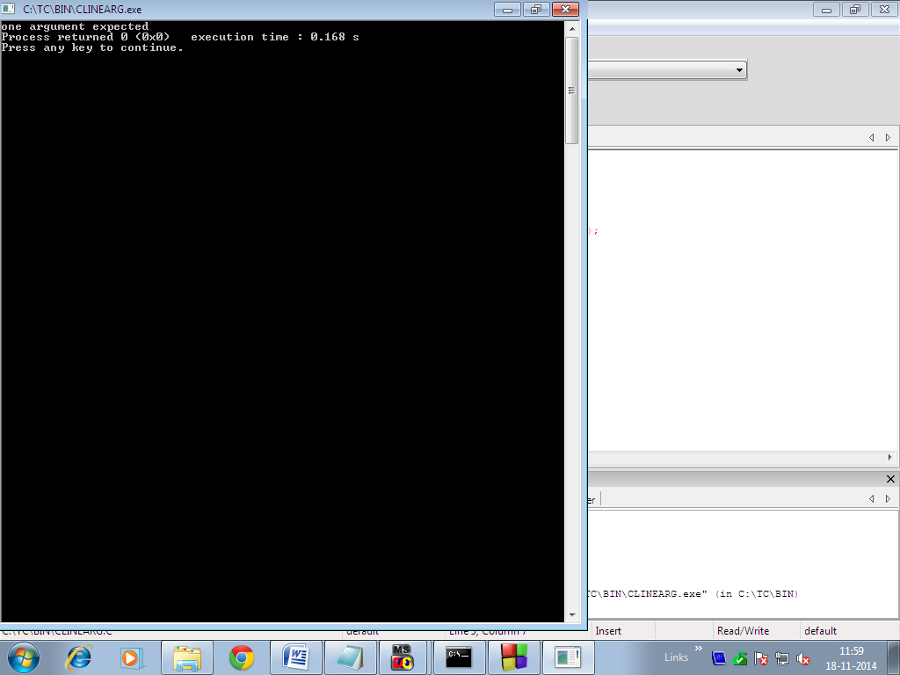
Output after running code blocks
Since no argument was passed so output comes as “one output expected”

Slide 74
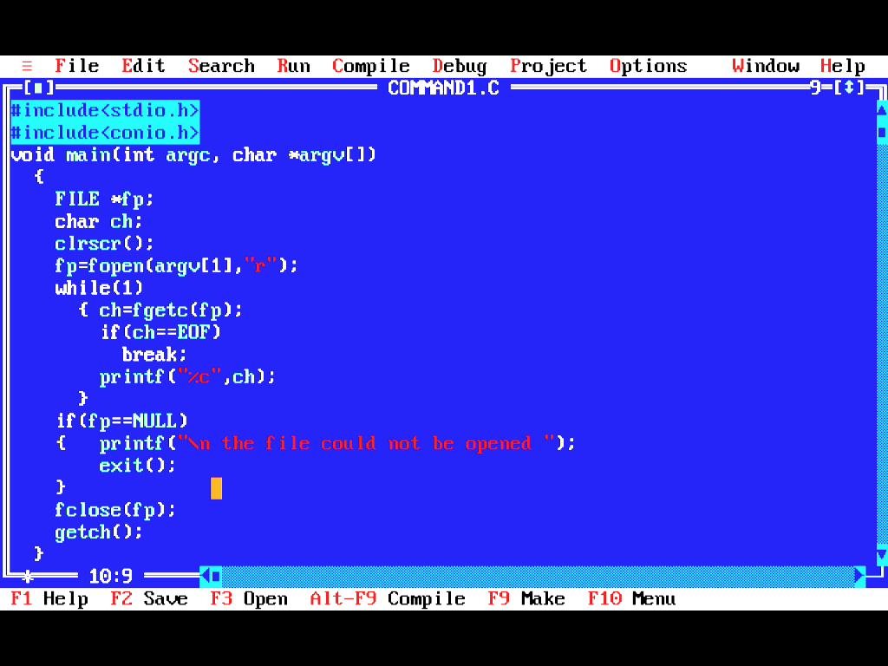
Program “COMMAND1.C”

Slide 75
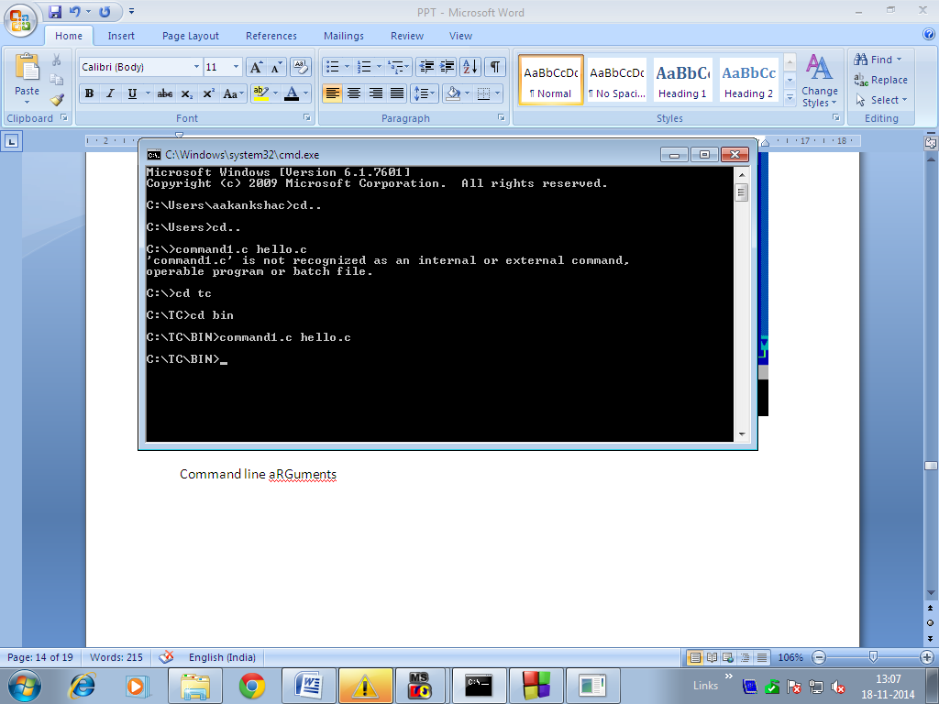
Command line arguments
argv[0]= command1.c
argv[1]=hello.c

Slide 76
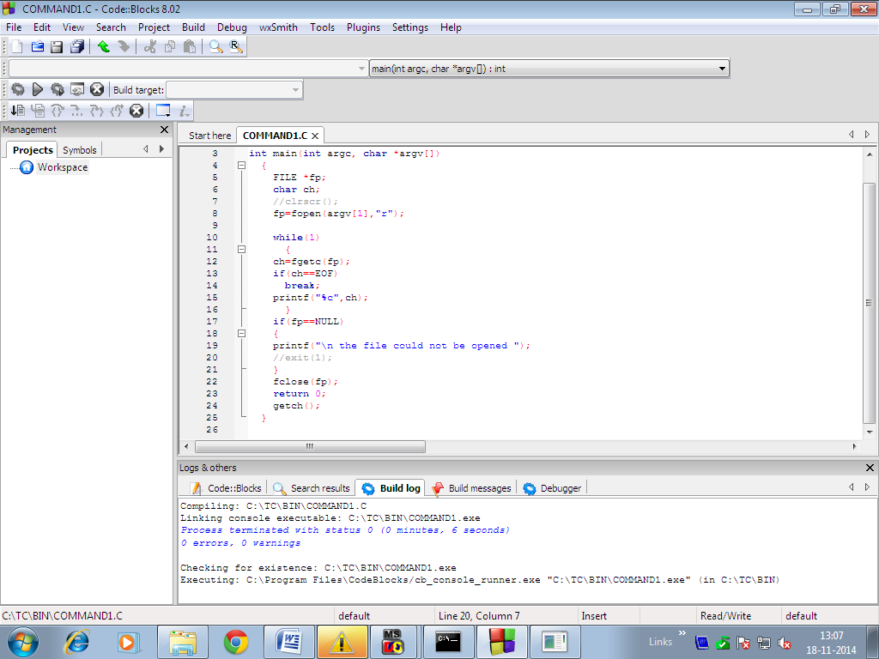
Code of Code blocks

Slide 77
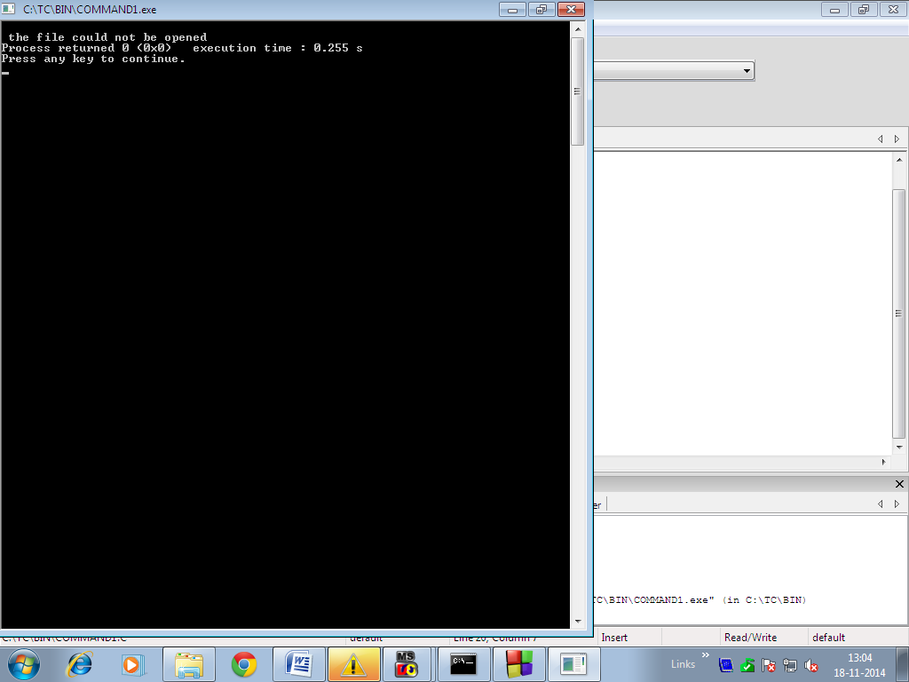
Output after running code blocks prog
Aakanksha Chopra(Asst. Prof. (IT))

